Slide 1
Applies Data Structure and Application
Dr Sachin K Saxena Sr Data Analyst, Portugal, MNC
Ex-Sr Software Engineer - Data Scientist

Slide 3
Content
Recursion: Recursive Definition and Processes
Recursion in C

Slide 4
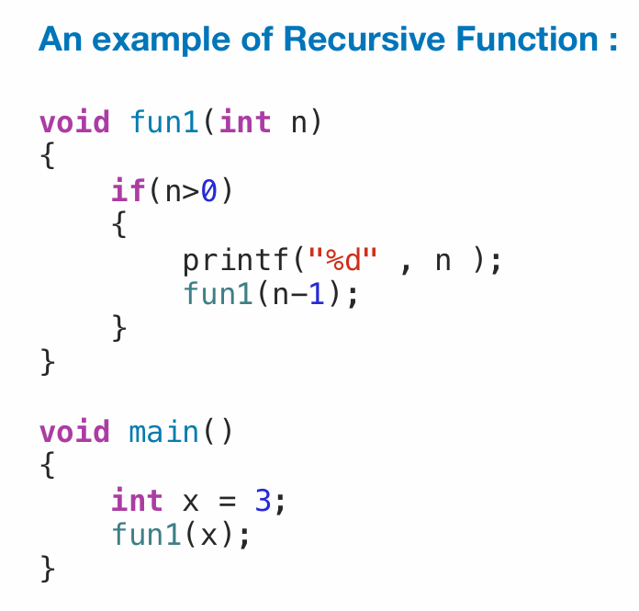
Recursive Definition and Processes
A function calling itself is called recursion

Slide 5
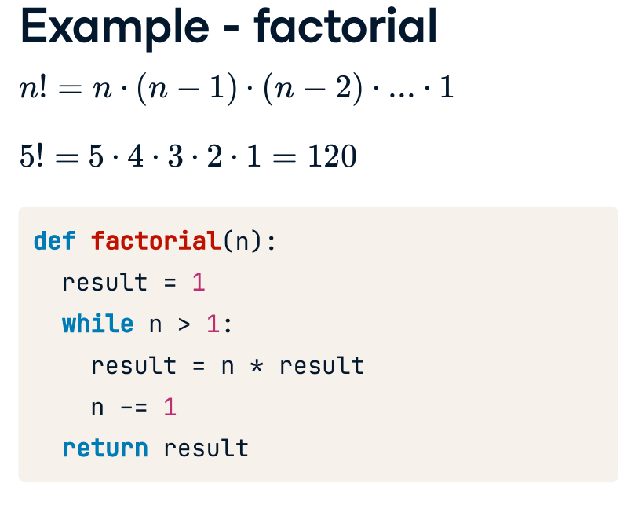
Recursive Definition and Processes
Almost all the situations where we use loops
substitute the loops using recursion
Can solve problems that seem very complex at first
Example - factorial n!

Slide 6
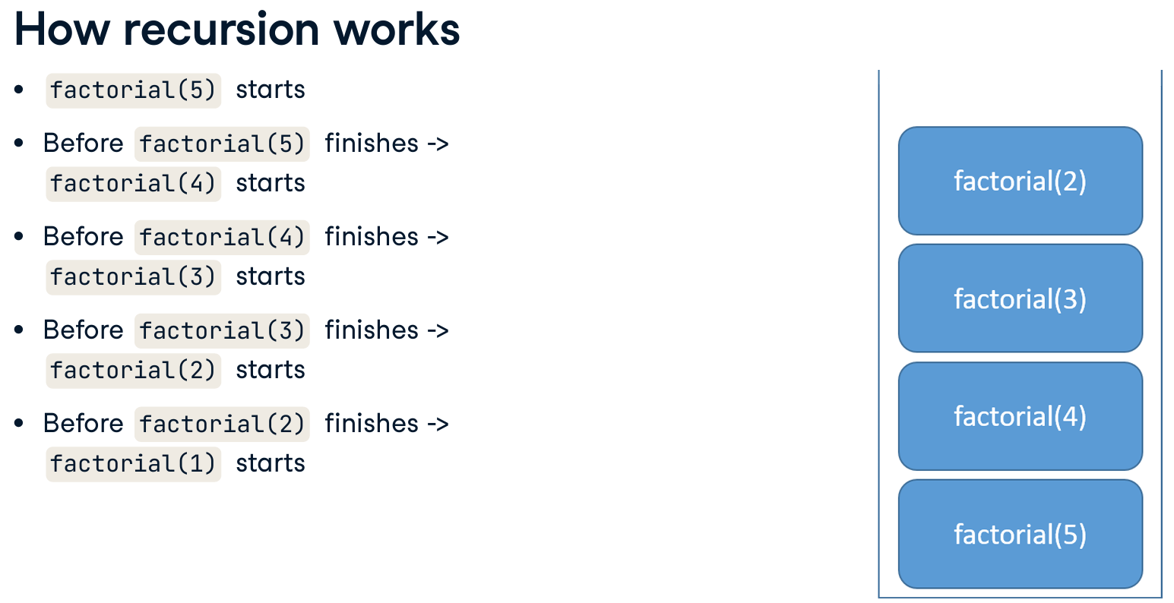
How Recursion Works?

Slide 7
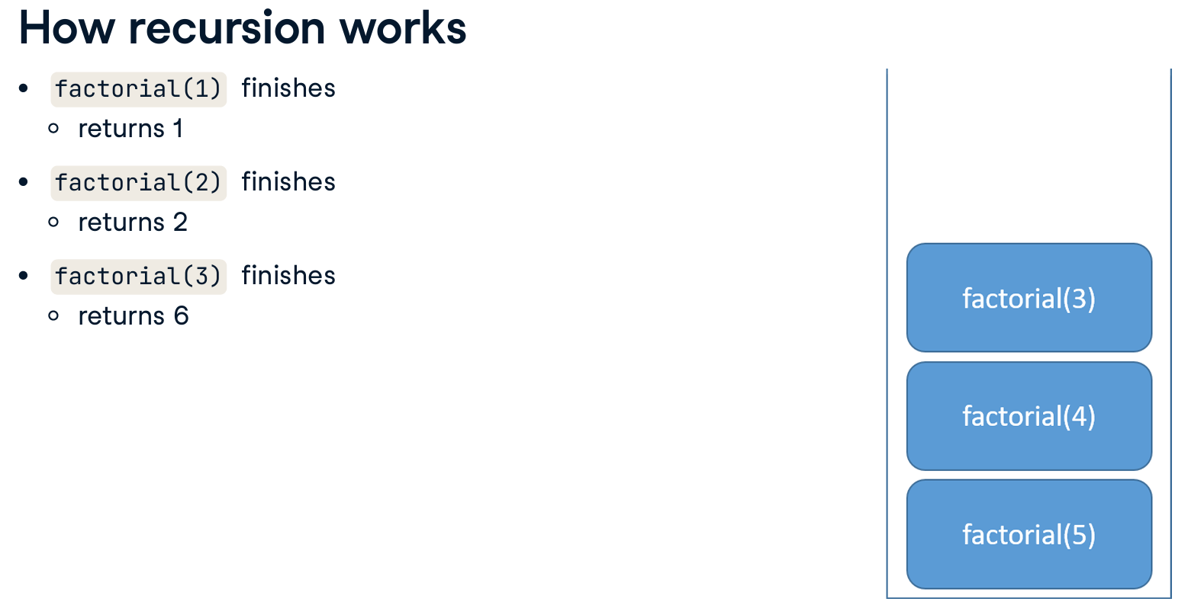
How Recursion Works?

Slide 8
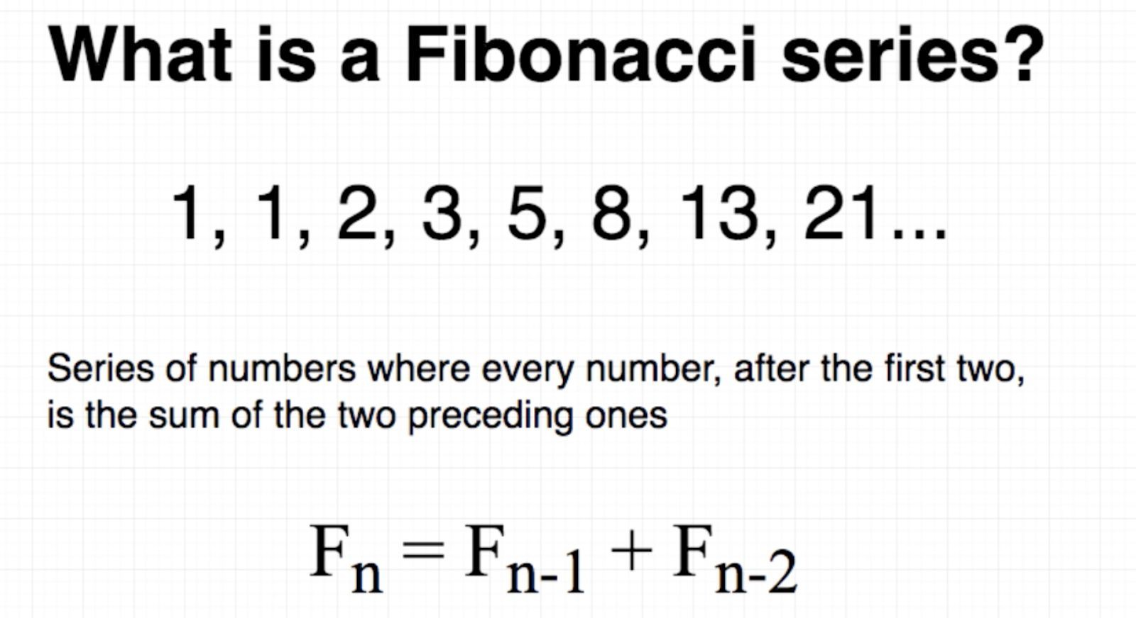
Recursion for Coding Practice and Interview Prep

Slide 9
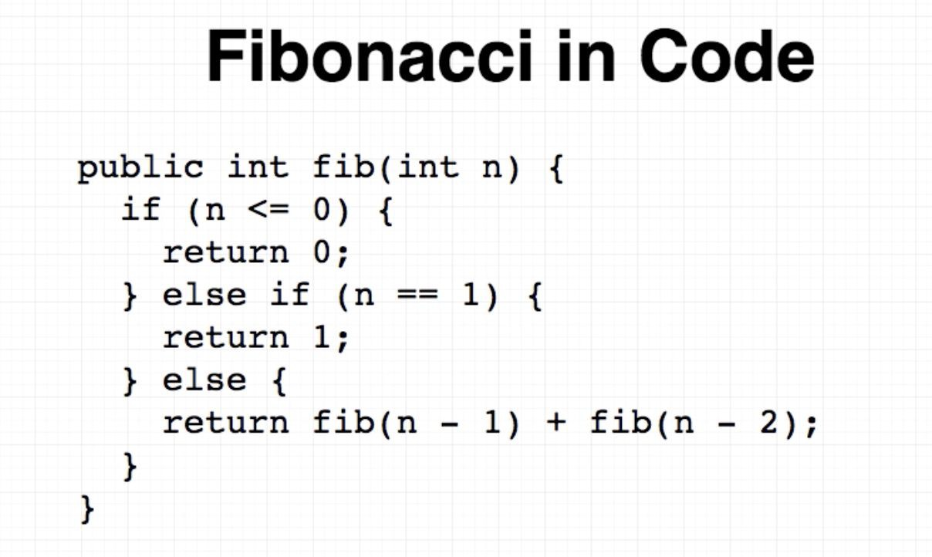
Recursion for Coding Practice and Interview Prep

Slide 10
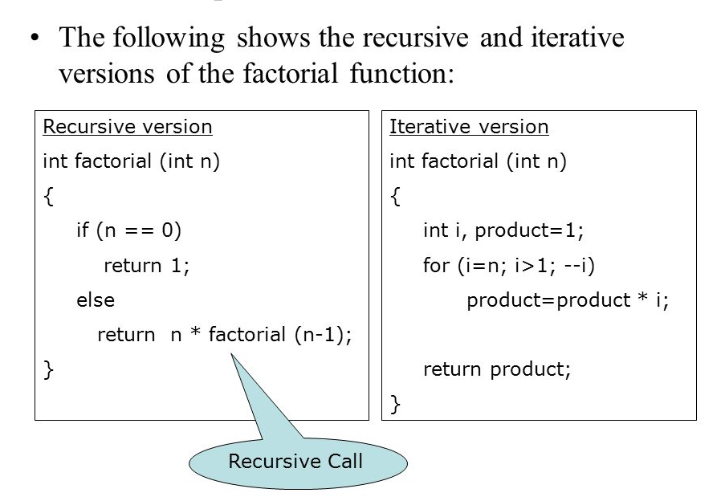
Recursive vs Iterative

Slide 11
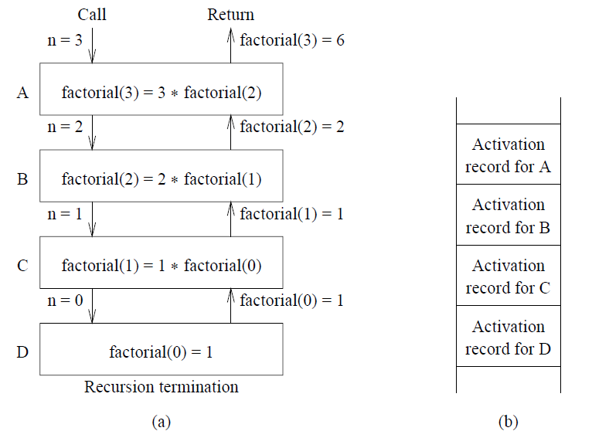
How Recursion works in C

Slide 12
How Recursion works in C
● Consider the following C function
int f(int n)
{
static int i = 1
if (n>=5)return n;
n = n+i;
i++;
return f(n);
}
the value returned by f(1) is

Slide 13
How Recursion works in C
● Consider the following C function
int f(int n)
{
static int i = 1
if (n>=5) return n;
n = n+i;
i++;
return f(n);
}
the value returned by f(1) is: 7

Slide 14
How Recursion works in C
● Consider the following C-program
void foo (int n, int sum)
{
int k = 0, j = 0;
if (n = = 0) return;
k = n % 10;
j = n/10;
sum = sum + k;
foo (j, sum);
printf(“%d”, k)
}
int main ()
{
int a = 2048, sum = 0;
foo (a, sum);
printf(“%d\n”, sum);
}
What does the above program print?

Slide 15
How Recursion works in C
● Consider the following C-program
void foo (int n, int sum)
{
int k = 0, j = 0;
if (n = = 0) return;
k = n % 10;
j = n/10;
sum = sum + k;
foo (j, sum);
printf(“%d”, k)
}
int main ()
{
int a = 2048, sum = 0;
foo (a, sum);
printf(“%d\n”, sum);
}
What does the above program print?
2, 0, 4, 8, 0

Slide 16
How Recursion works in C++
● What is the return value of f(p, p), if the value of p is initialised to 5 before the call? Note that the first parameter is passed by reference, whereas the second parameter is passed by value.
int f (int &x, int c)
{
c = c - 1;
if (c = = 0) return 1;
x = x + 1;
return f(x,c) * x;
}
int main()
{
int p=5;
printf("%d",f(p,p));
}

Slide 17
How Recursion works in C++
● What is the return value of f(p, p), if the value of p is initialised to 5 before the call? Note that the first parameter is passed by reference, whereas the second parameter is passed by value.
int f (int &x, int c)
{
c = c - 1;
if (c = = 0) return 1;
x = x + 1;
return f(x,c) * x;
}
int main()
{
int p=5;
printf("%d",f(p,p));
}
Answer: 6561

Slide 18
How Recursion works in C
● Consider the following C function.
int fun (int n)
{
int x=1, k;
if (n==1) return x;
for (k=1; k<n; ++k)
x=x + fun (k) * fun (n - k);
return x;
}
The return value of fun (5) is

Slide 19
How Recursion works in C
● Consider the following C function.
int fun (int n)
{
int x=1, k;
if (n==1) return x;
for (k=1; k<n; ++k)
x=x + fun (k) * fun (n - k);
return x;
}
The return value of fun (5) is
Answer: 51

Slide 20
How Recursion works in C
● What will be the output of the following C program?
void count(int n)
{
static int d = 1;
printf("%d", n);
printf("%d", d);
d++;
if (n > 1) count (n-1);
printf("%d", d);
}
void main( )
{
count (3);
}

Slide 21
How Recursion works in C
● What will be the output of the following C program?
void count(int n)
{
static int d = 1;
printf("%d", n);
printf("%d", d);
d++;
if (n > 1) count (n-1);
printf("%d", d);
}
void main( )
{
count (3);
}
Answer: 3 1 2 2 1 3 4 4 4

Slide 22
Thanking you !!!!
Any question !!!!!
Download PPT : https://github.com/sachin365123/Applies-Data-Structure-and-Application-GLA-Online-Sessions-Jan---Jun-2026

